Slide 1



FURLICENSE
Alasan, Julianna Joyce
Baquero, Riza Mae
Salvaleon, Jed
Dagasuhan, Jedia Nicole
Agusan, Joshua
NAME OF PRESENTER
Designation

Slide 2

INTRODUCTION
The FurLicense System is an innovative platform designed to simplify and streamline pet licensing and registration processes. It serves both pet owners (customers) and administrators, providing distinct functionalities for each.
For customers, the system offers:
An intuitive dashboard to register pets, renew licenses, and view personal and pet information.
A seamless process for submitting new registrations and renewals.
For administrators, the system allows:
Efficient management of license applications, including approving or declining requests.
The ability to monitor and modify the validity of licenses as needed.
Although the system is highly efficient, it has some limitations, such as the inability to upload images or provide feedback. Despite this, FurLicense enhances convenience, reduces manual effort, and ensures better compliance in pet licensing processes.

Slide 3
Objectives
1. Streamline Pet Licensing Application
Simplify the pet licensing application by allowing users to submit their information and requirements online, eliminating the need for multiple visits to the licensing office.
2. Reduce Waiting Time for Pet Owners
Minimize the time spent by pet owners in submitting their applications by providing a system that automates status tracking and centralizes information.
3. Enhance Accessibility and Convenience
Offer a user-friendly platform that makes the licensing process more accessible, particularly for individuals with limited mobility, busy schedules, or those who prefer online solutions over in-person interactions.

Slide 4
Scope and Delimitation
The FurLicense System streamlines pet license registration and renewal for both customers and administrators. Customers can register accounts, submit applications, and view their personal and pet information, while administrators manage user accounts, handle license requests, and set license validity, with the ability to invalidate licenses if necessary. However, customers cannot update their personal and pet information once submitted. The system also has other limitations, such as the inability to upload images, provide feedback, or support renewals for licenses issued outside the platform. Customers are not notified of declined requests but can view approved licenses in the Active Licenses section. Despite these constraints, FurLicense offers an effective and organized platform for managing pet licensing processes.

Slide 5
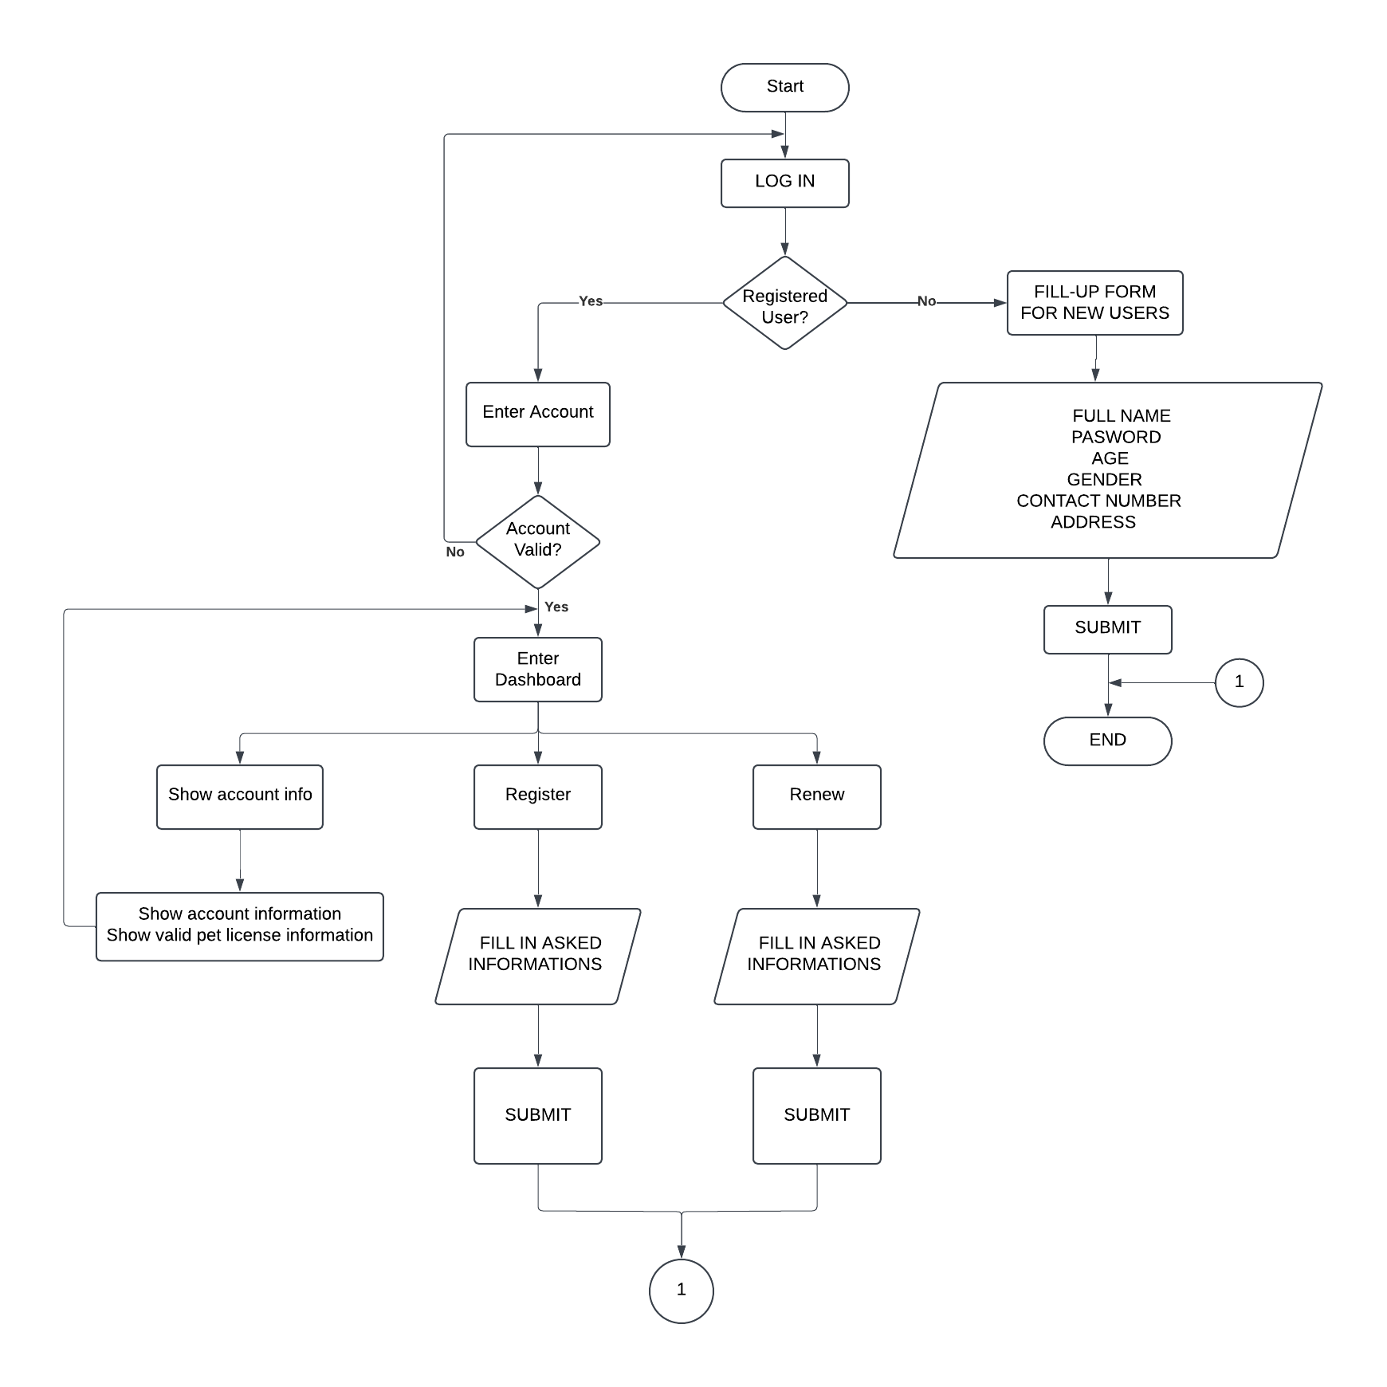
FLOWCHART
CUSTOMER SIDE SYSTEM FLOW CHART

Slide 6
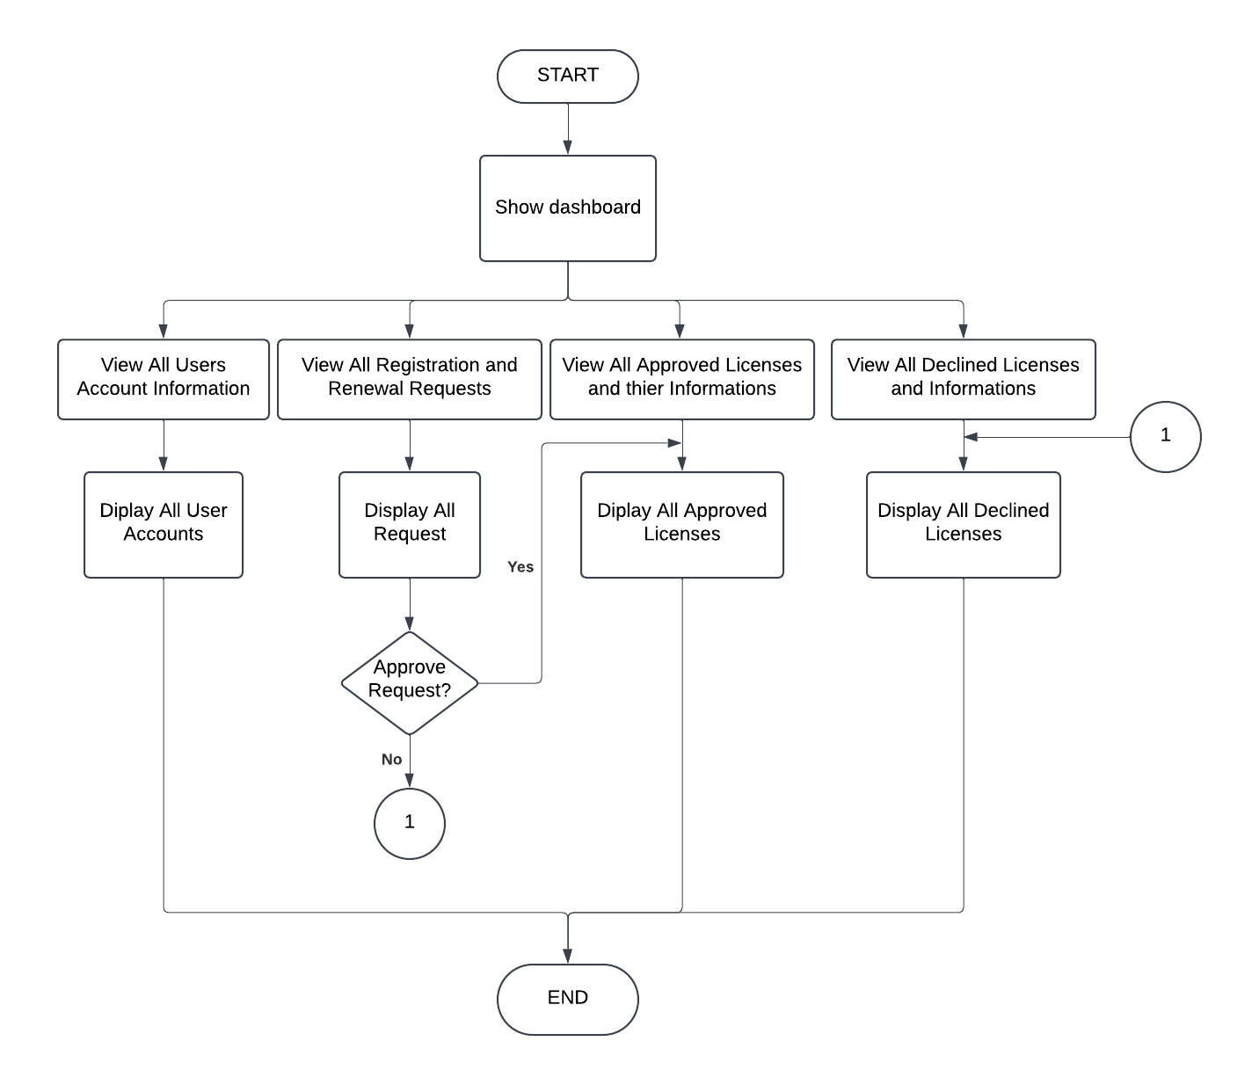
FLOWCHART
ADMINISTRATOR SIDE SYSTEM FLOW CHART

Slide 7
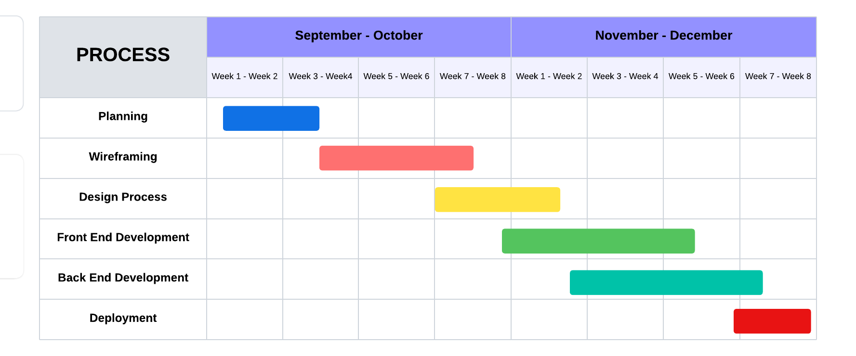
GANTT CHART

Slide 8
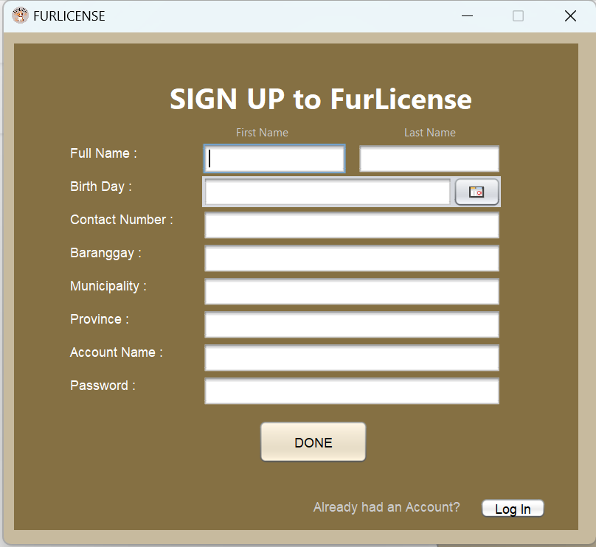
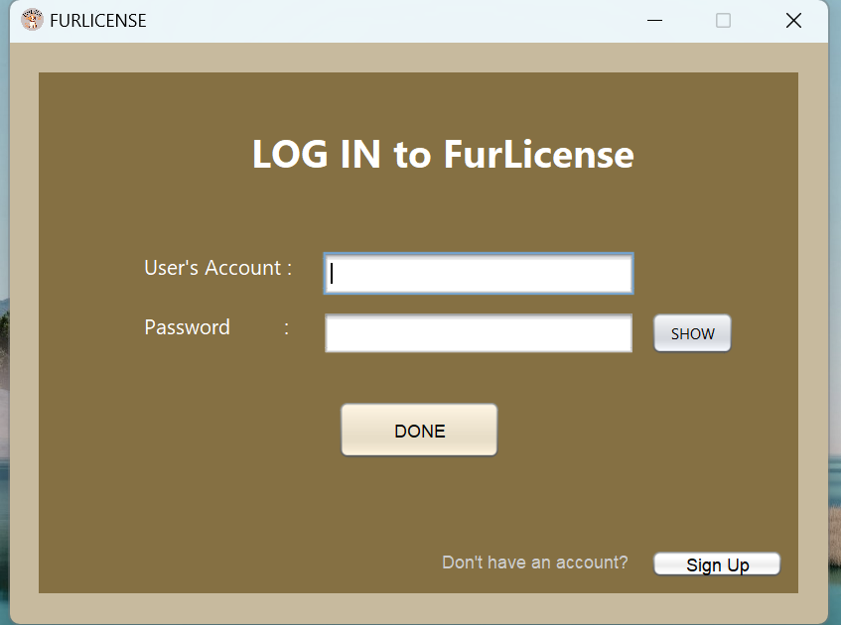
SYSTEM DESIGN
CUSTOMER SIDE SYSTEM DESIGN

Slide 9
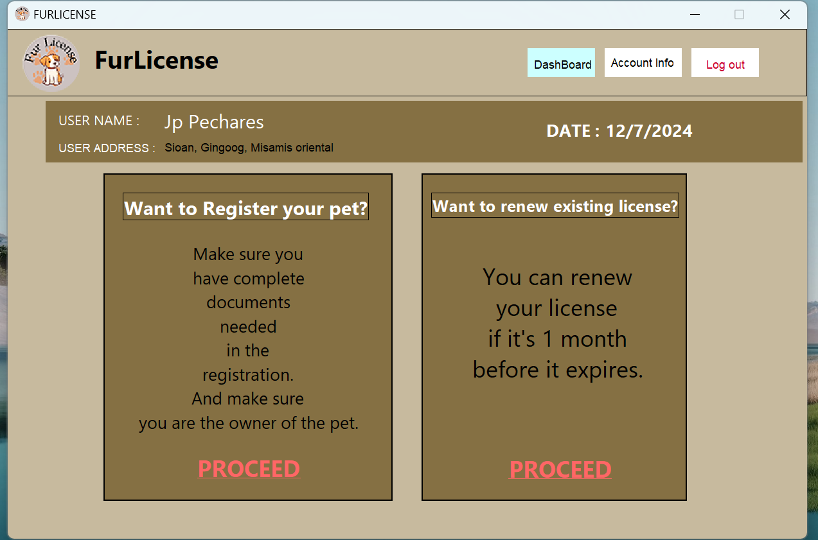
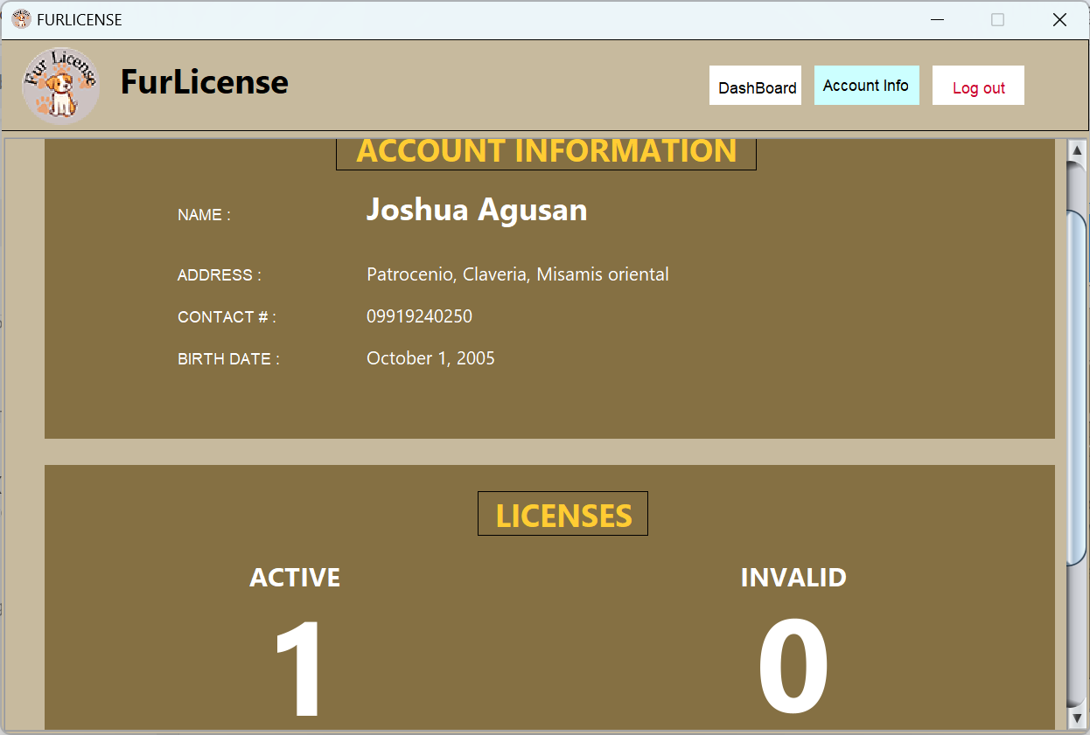
SYSTEM DESIGN
CUSTOMER SIDE SYSTEM DESIGN

Slide 10
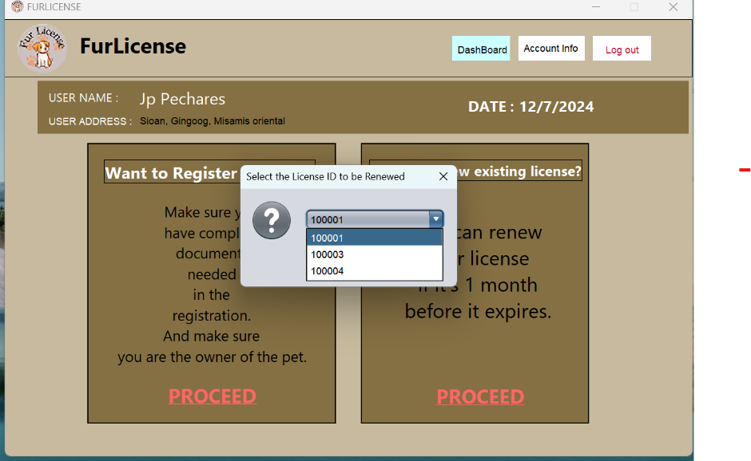
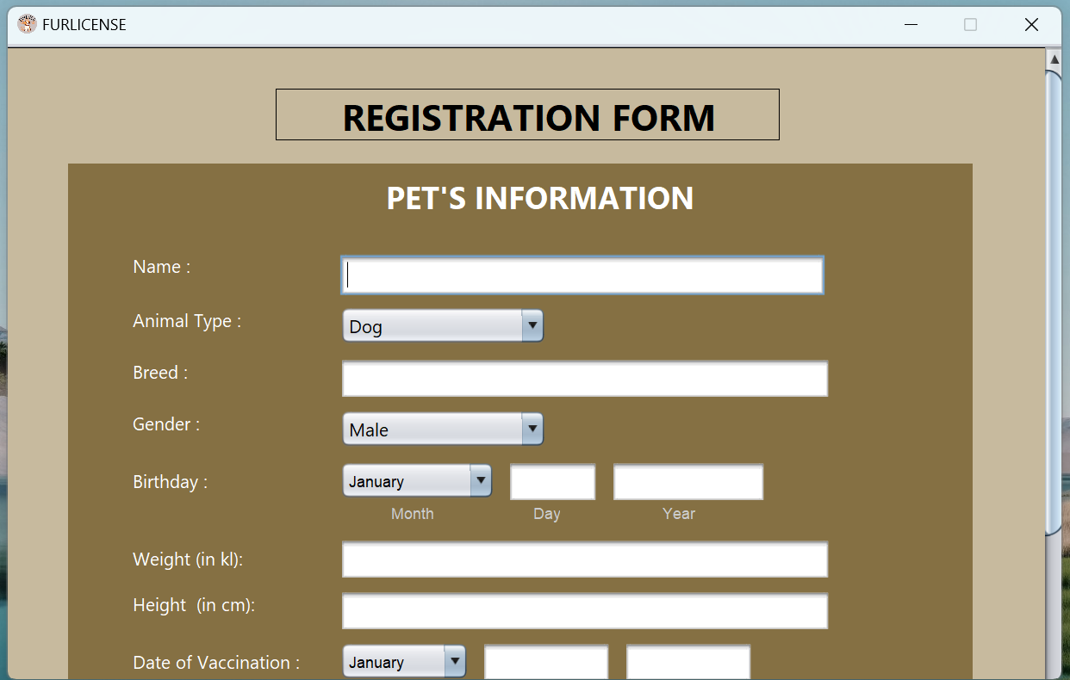
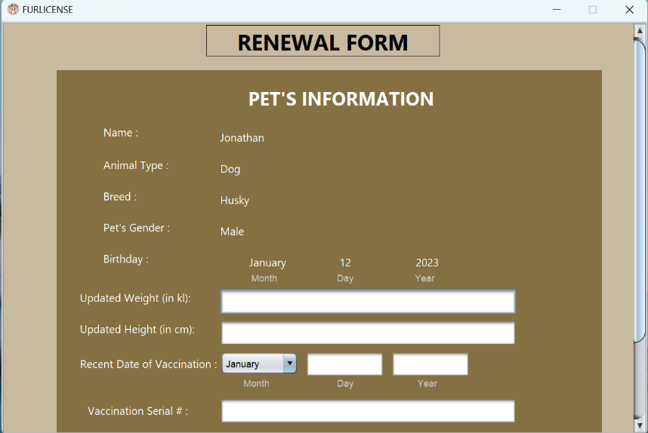
SYSTEM DESIGN
CUSTOMER SIDE SYSTEM DESIGN

Slide 11
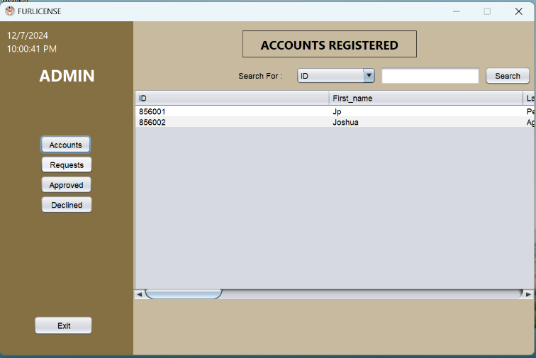
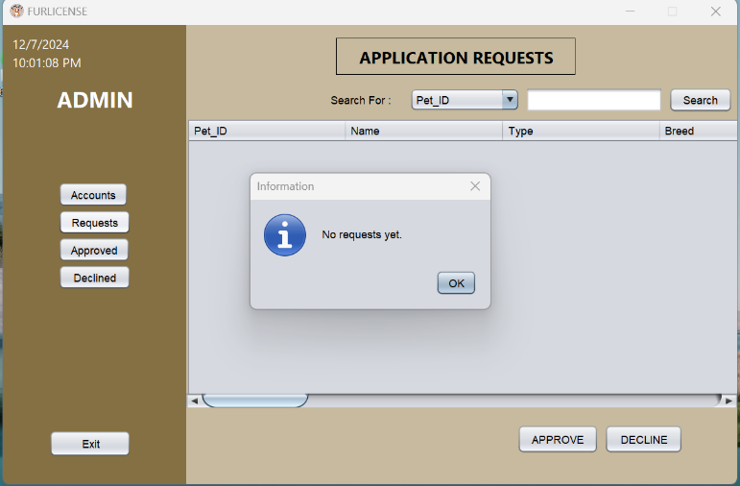
SYSTEM DESIGN
ADMINISTRATOR SIDE SYSTEM DESIGN

Slide 12
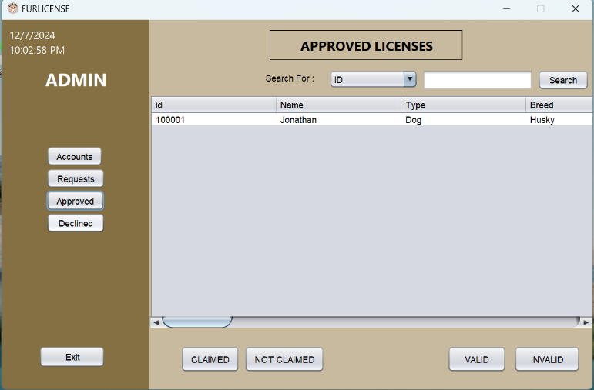
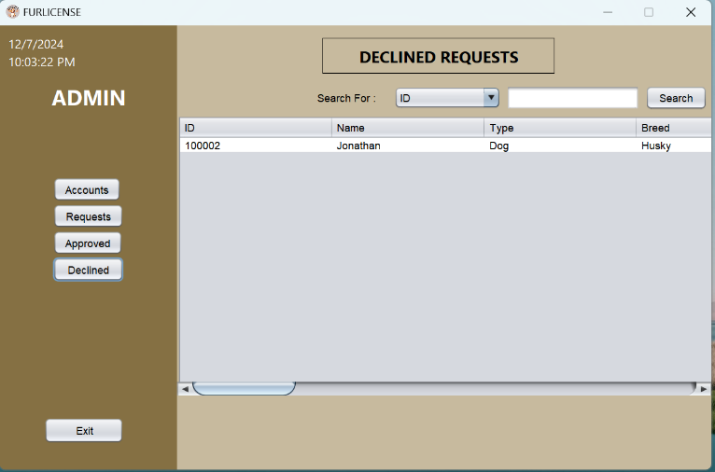
SYSTEM DESIGN
ADMINISTRATOR SIDE SYSTEM DESIGN

Slide 13
CONCLUSION
The FurLicense System modernizes the pet licensing process by offering enhanced convenience for users through a digital platform that simplifies registration and renewal, reducing office visits and improving accessibility. It streamlines operations with automated processes and user-friendly interfaces, minimizing waiting times and boosting efficiency. However, users cannot update their personal or pet information once submitted. The system also acknowledges other limitations, such as the absence of photo uploads, feedback mechanisms, and declined request notifications. Despite these constraints, they do not overshadow its primary goal of improving the licensing experience. Overall, the system represents a significant step toward public service modernization, providing a foundation for future enhancements and broader applications in administrative processes.

Slide 14
RECOMMENDATION
To enhance the FurLicense System's functionality and user experience, the following key recommendations are proposed:
Implement a Notification System: Notify users of declined requests to improve communication and reduce uncertainty.
Enable Photo Upload Features: Allow users to upload pet photos and documents to streamline verification and eliminate physical submissions.
Incorporate Feedback Mechanisms: Add a feedback feature to enable users to report issues and suggest improvements.
Expand System Compatibility: Support license renewals not initially registered through the platform to increase system usability.
Enhance Admin and User Functionality: Allow administrators and users to modify user and license information for better record management.
Addressing these recommendations will boost system efficiency, flexibility, and user satisfaction, making it a more comprehensive solution for pet licensing management.

